Slide 1
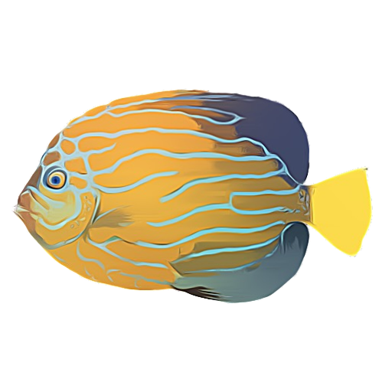
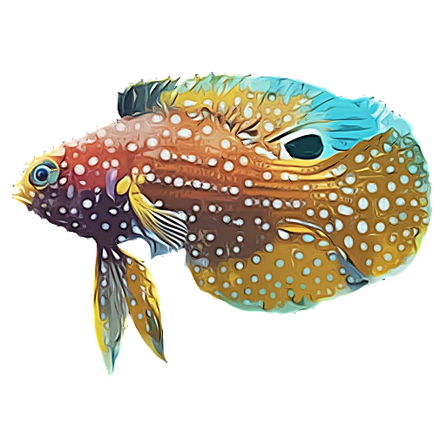
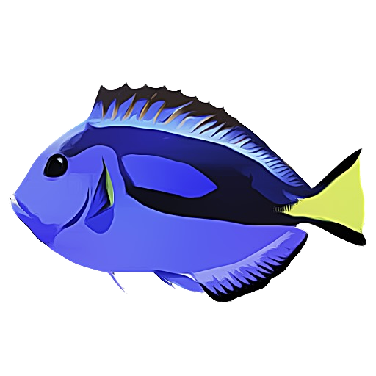
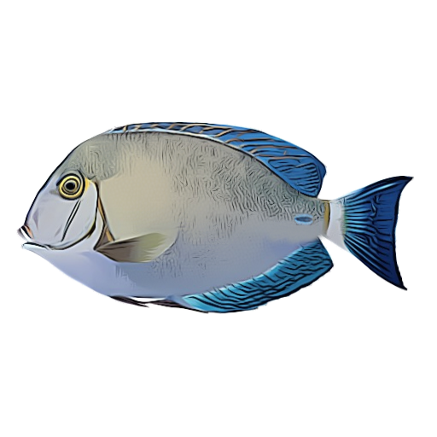
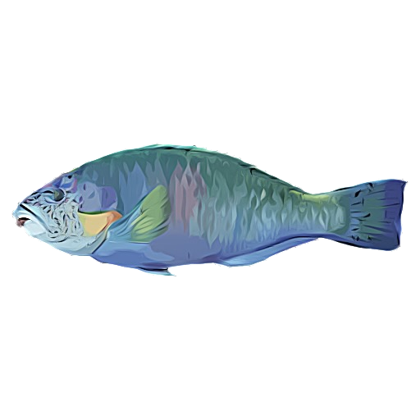
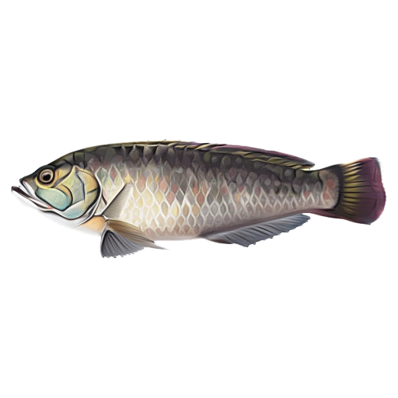
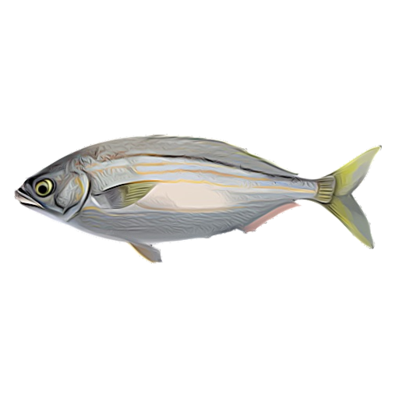
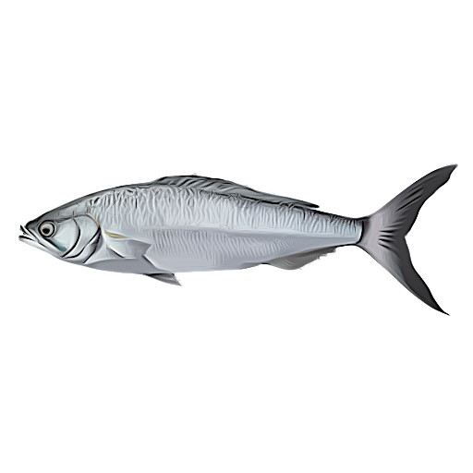
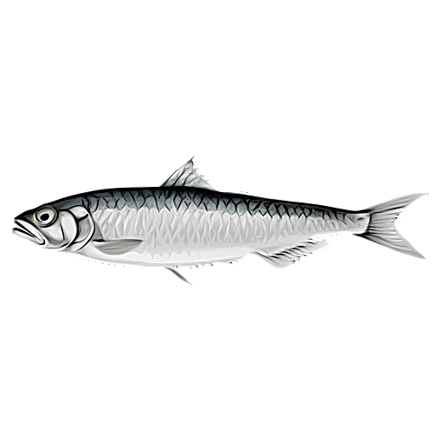
a)
High
Intermediate
Low
Chaetodontoplus
septentrionalis
Calloplesiops
altivelis
Paracanthurus
hepatus
Acanthurus
blochii
Scarus
rivulatus
Pseudolabrus
guentheri
Sarpa
salpa
Arripis
truttacea
Sardina
pilchardus
b)
c)

